Slide 1
What does he do at school?
Study
He studies

Slide 2
What do they do at work?
Fight
They fight at work.

Slide 3
What does he do in the mornings?
Clean
He cleans the house

Slide 4
What does he do in his free time?
Draw
He draws in his free time

Slide 5
What does she do in the mornings?
Wait
She waits for the bus.

Slide 6
What does she do in the afternoon?
Play soccer
She plays soccer in the afternoons

Slide 7
What does he do in the mornings?
Cook
He cooks breakfast.

Slide 8
What does he do in his free time?
Play the piano
He plays the piano in his free time

Slide 9
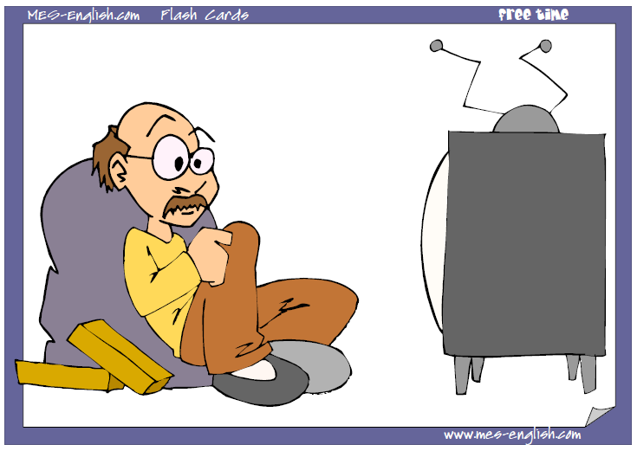
What does he do in his free time?
watch TV
He watches TV in his free time

Slide 10
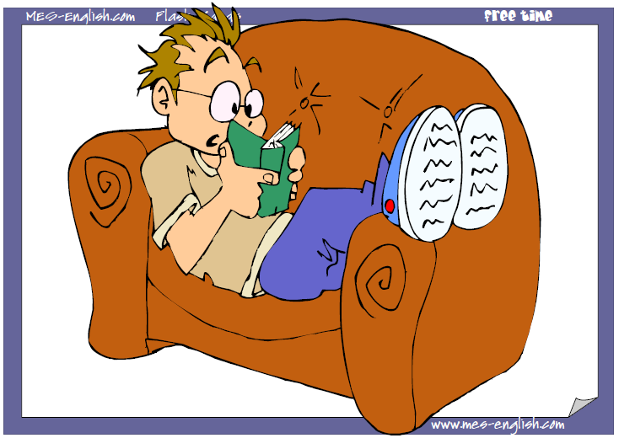
What does he do in his free time?
read
He reads in his free time

Slide 11
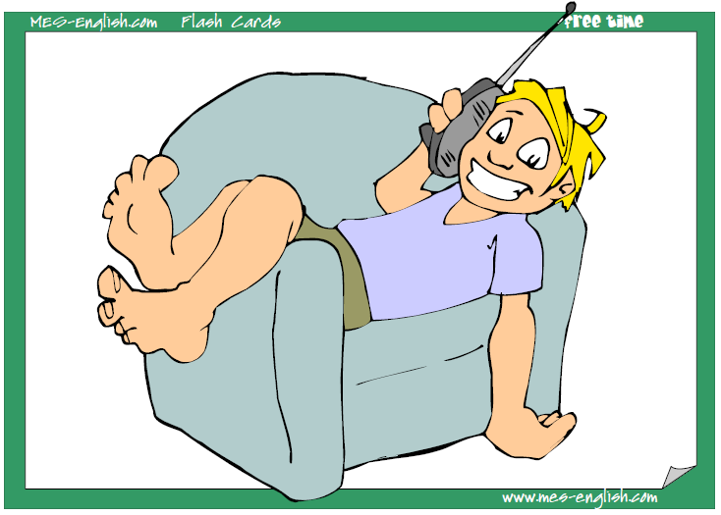
What does he do in his free time?
talk on the phone
He talks on the phone in his free time

